Slide 1
Weather and farm animals in Mongolia
Correlation between number of farm animals and climate change

Slide 2
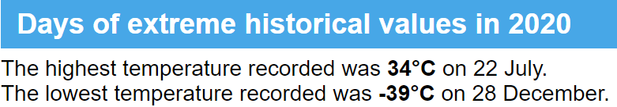
Between -30°in winter and 30°in summer
The climate is strongly continental, with long, frigid winters and short, warm summers.

Slide 3
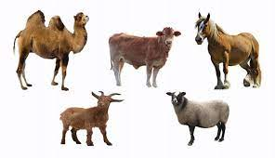
As precious as jewels : 5 snouts
The traditional herd animals of the Mongolians are horses, sheep, goats, cows and camels.

Slide 4
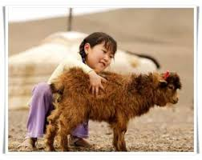
Why did I choose this topic?
A grant announced by the government for goats in 2008 is accused to improve number of goats which is ruining Mongolia’s grasslands and causing soil drought

Slide 5
How did I proceed?
1
See if rise of average temperature is real
See if the rise of the number of goats is exceptional compared to the rise of other animals
4
See if there is a correlation between the rise of average temperature and the number of goats
2
3
See if there is a correlation between the rise of average temperature and the number of animals

Slide 6
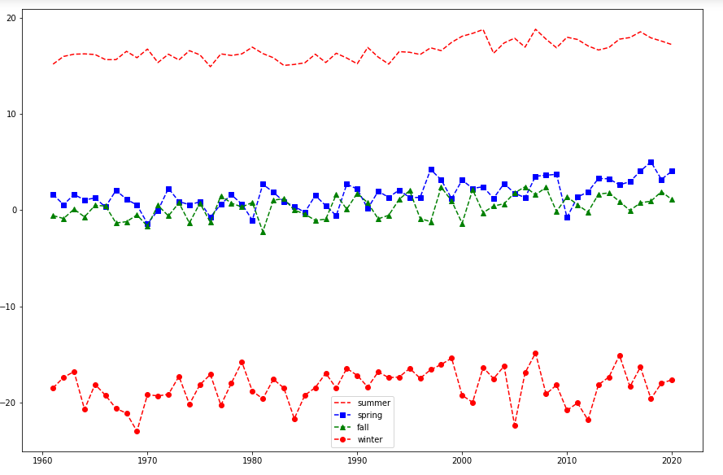
Average temperature by season since 1960
1

Slide 7
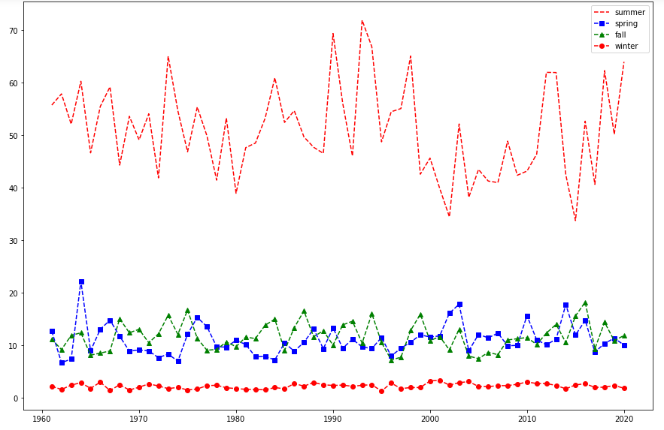
Average rainfall by season since 1960
1

Slide 8
2

Slide 9
3

Slide 10
Difficulties
Credits
Retrieve data from multiple website
Volume of dataset
Translate data into english
Merge several tables with different structure to create one dataset

Slide 11
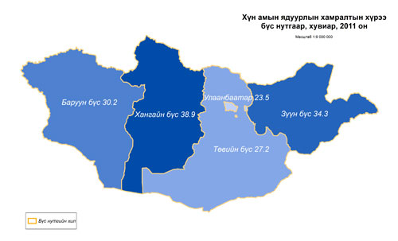
Going further …
Analysing data by region
Analysing economical data (rise of goat)
Analysing industrial data (rise of temperature)

